Slide 1
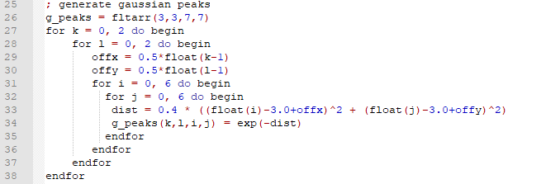
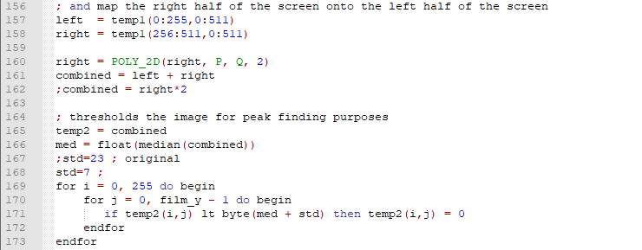
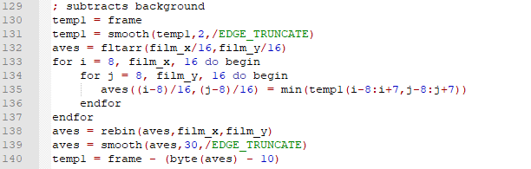
Code in IDL: ffp
4 (half pixel) positions for the COM
Transform+threshold
Background subtraction

Slide 2
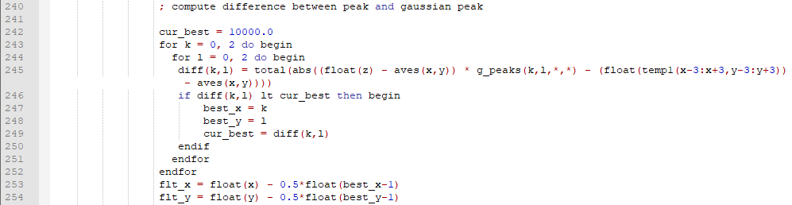
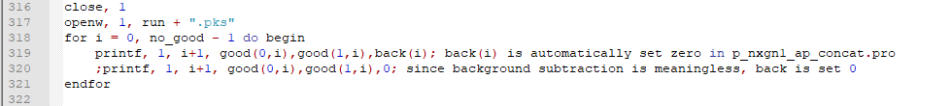
In ffp
Half pix location gaussian is found

Slide 3

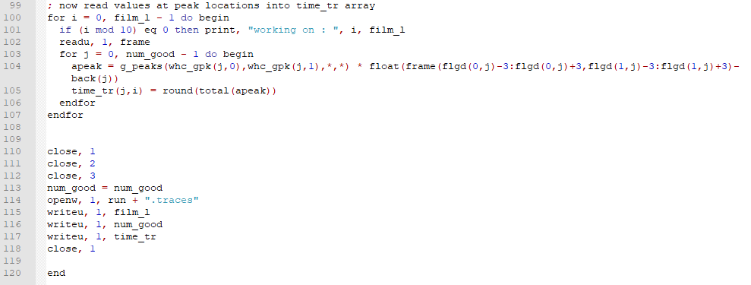
In ap extract the traces

Slide 4
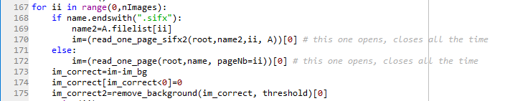


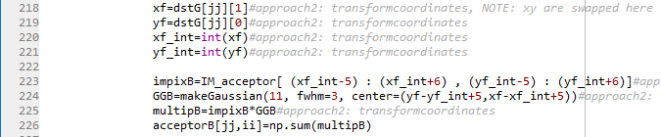
In python (applyMapping)
Loop over images.
Remove background
Threshold
Loop over found spots
Crop image+multiply with gaussian
Transform acceptor locations+extract

